Slide 1
Summer Term 23 Responsible Artificial Intelligence Lecture-6: Normative Argumentation
Prof. Dr. Holger Giese (holger.giese@hpi.uni-potsdam.de)
Christian Medeiros Adriano (christian.adriano@hpi.de) - “Chris”
Christian Zöllner (christian.zoellner@hpi.de)
Matthias Barkowsky (matthias.barkowsky@hpi.de)

Slide 2
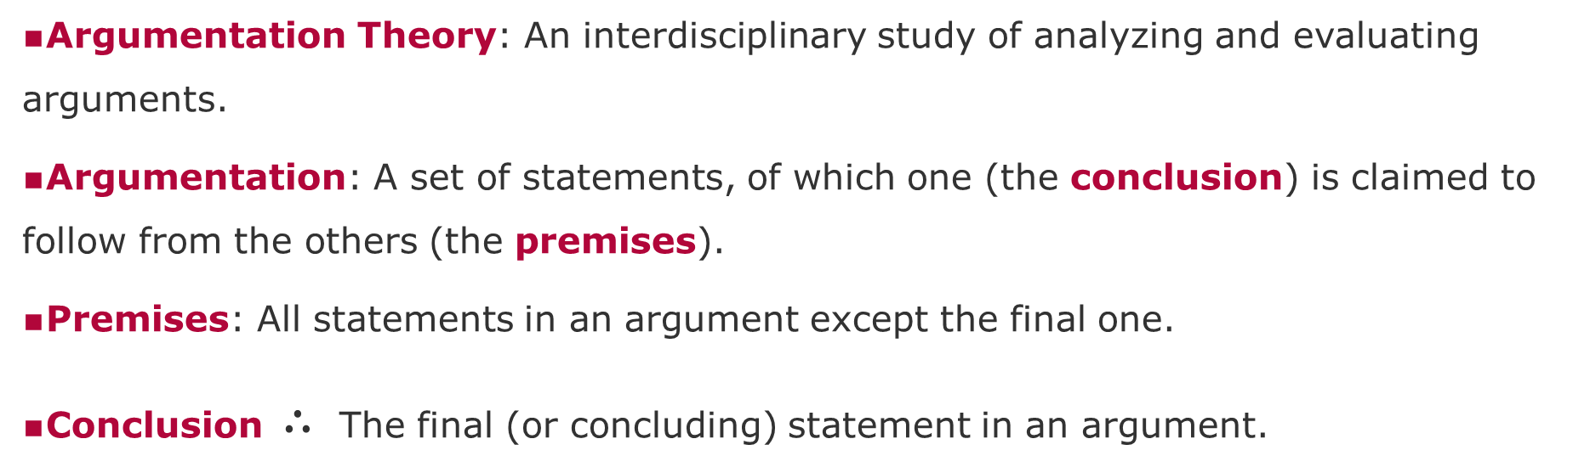
Normative Argumentation - Nomenclature
[dePoel&Royakkers2011]
Argumentation Theory: An interdisciplinary study of analyzing and evaluating arguments.
Argumentation: A set of statements, of which one (the conclusion) is claimed to follow from the others (the premises).
Premises: All statements in an argument except the final one.
Conclusion $∴$ The final (or concluding) statement in an argument.
Notes:
[dePoel&Royakkers2011] Chapter 3, 4, 5
[Pereira&Saptawijaya2016] p. 110 trolly problem in different forms? Use to explain differences?
[Pereira&Saptawijaya2016] p. 20 double and triple effect & trolly problem
[Kizza2013] Chapter 3 Ethics abd Ethecial Analysis
[Reynolds2009] p. 19; overview

Slide 3
Normative Argumentation - Valid
[dePoel&Royakkers2011]
Valid Argumentation: An argument whose conclusion follow with necessity from its premises: if the premises are true, the conclusion must be true.
modus ponens: Latin for "method of affirming."
A rule of inference used to draw logical conclusions.
if p is true, and if p implies q (p and q), then q is true.
“q” follows from “if p then q” and “p”
modus ponens
p: It is not raining today
q: Therefore, I will did not wear my raincoat
Notes:
[dePoel&Royakkers2011] Chapter 3, 4, 5
[Pereira&Saptawijaya2016] p. 110 trolly problem in different forms? Use to explain differences?
[Pereira&Saptawijaya2016] p. 20 double and triple effect & trolly problem
[Kizza2013] Chapter 3 Ethics abd Ethecial Analysis
[Reynolds2009] p. 19; overview

Slide 4
Normative Argumentation - Fallacy
[dePoel&Royakkers2011]
Fallacy: An error or deficiency in an argument. A conclusion does not follow from the premises.
modus tollens: Latin for "method of denying."
It is a rule of inference drawn from the combination of modus ponens and the contrapositive.
If q is false, and if p implies q (pq), then p is also false.
“not p” follows from “if p then q” and “not q”
modus tollens
p: I did not wear my raincoat
q: Therefore, it is not raining today
From modus tollens,
if q is false (i.e., it is raining today),
then p is also false (i.e., I am wearing my raincoat)
Notes:
Argument Forms - https://www.csm.ornl.gov/~sheldon/ds/sec1.3.html
[dePoel&Royakkers2011] Chapter 3, 4, 5
[Pereira&Saptawijaya2016] p. 110 trolly problem in different forms? Use to explain differences?
[Pereira&Saptawijaya2016] p. 20 double and triple effect & trolly problem
[Kizza2013] Chapter 3 Ethics abd Ethecial Analysis
[Reynolds2009] p. 19; overview

Slide 5
Descriptive before Prescriptive Claims/Arguments
Descriptive: The autonomous system is equipped with a decision-making module that is trained on normal and exceptional situations.
Prescriptive: The autonomous system should not make decisions that endanger people’s lives. When faces with a dilemma, it should try to delegate the decision to a human.
We do not want to make prescriptive claims without proper descriptive ones.
Because we do not want to suggest (prescribe) solutions to a problem without having understood (described) the problem very well.

Slide 6
Types of arguments
Deductive (if premises are true, then the conclusion is true)
Inductive
Abductive
Argument by analogy
Reduction ad absurdum

Slide 7
Validity versus Truth
Validity tells me that “an argument is valid if conclusion follows logically from the premises”
However, an argument being valid does not imply that the conclusion is true.
Valid but not True Argument
Premise-1: Self-driving cars do not need a human to drive
Premise-2: Human drivers are the main causes of fatal accidents
Conclusion: Self-driving cars cause fewer fatal accidents
FALSE
FALSE
TRUE
Valid but not True Argument
Premise-1: Robots follow the 1st Asimov law – “a robot shall not harm a human, or by inaction allow a human to come to harm
Premise-2: Autonomous weapons are robots
Conclusion: Autonomous weapons are safe
TRUE
TRUE
FALSE
Deductive Soundness = validity + all premises are true
Notes:
The second law is that a robot shall obey any instruction given to it by a human

Slide 8
Similarities and Dissimilarities
If you have shown that two things are the same, can you later discover that they are distinct?
→ Yes, by discovering some hidden property, latent variable, which can be relationship or generative process.
If you have shown that two things are distinct, can you later discover that they are the same?
→ Yes, via some abstraction (relationship, type) or an exogenous process.

Slide 9
Inductive Arguments
Premise-1: Most technology that evolves tends to become safer than older technology
Premise-2: Self-Driving cars are an evolving technology
Conclusion: Hence, self-driving cars will probably be safer than regular cars
Caveat
Future not always resembles the past

Slide 10
Abduction
Drawing a conclusion based on the explanation that best explains a state of events, rather from evidence provided by the premises. Also known as "inference to the best explanation".
“When you eliminate all the impossible, whatever remains, however improbable, must be the truth.” Sherlock Holmes

Slide 11
Deductive and Non-Deductive Arguments
[dePoel&Royakkers2011]
Deductive Argument: An argument which has a conclusion that is enclosed in (implied by) the premises.
Valid arguments are deductive (monotonic), but in practice we often use non-deductive (non-monotonic) arguments where the conclusion is logically stronger than the premises.
Plausibility Principle: The principle that enumeration and supplementary argumentation in a non-deductive argumentation can make the conclusion plausible (acceptable).
Notes:
[dePoel&Royakkers2011] Chapter 3, 4, 5
[Pereira&Saptawijaya2016] p. 110 trolly problem in different forms? Use to explain differences?
[Pereira&Saptawijaya2016] p. 20 double and triple effect & trolly problem
[Kizza2013] Chapter 3 Ethics abd Ethecial Analysis
[Reynolds2009] p. 19; overview

Slide 12
Critical Questions for Non-Deductive Arguments
[dePoel&Royakkers2011]
Inductive Argument: A type of non-deductive argumentation. Arguments from a particular to the general.
Critical Questions: Questions belonging to a certain type of non-deductive argumentation to check the degree of plausibility of a conclusion. Example critical questions for an Inductive Argument:
Were the experiments carried out relevant for the conclusion?
Were sufficient experiments carried out to support the conclusion?
Are there no counterexamples?
Sound Argumentation: An argumentation for which the corresponding critical questions can be answered positively and which therefore makes the conclusion plausible if the premises are true.
Notes:
[dePoel&Royakkers2011] Chapter 3, 4, 5
[Pereira&Saptawijaya2016] p. 110 trolly problem in different forms? Use to explain differences?
[Pereira&Saptawijaya2016] p. 20 double and triple effect & trolly problem
[Kizza2013] Chapter 3 Ethics abd Ethecial Analysis
[Reynolds2009] p. 19; overview

Slide 13
Types of Arguments
[dePoel&Royakkers2011]
Argumentation by Analogy: A type of non-deductive argumentation. An argumentation based on comparison with another situation in which the judgment is clear. The judgement is supposed also to apply to the analogous situation. Critical questions:
Are the two situations really comparable?
Is the judgement for the analogous situation really clear?
Means-end Argumentation: A type of non-deductive argumentation. An argumentation in which from a given end the means is derived to realize the end. Critical questions:
Does the mean realize the end? 2. Can the means be carried out?
Are there any side effects? 5. Is the end acceptable?
Are there better means to achieve the end?
Notes:
[dePoel&Royakkers2011] Chapter 3, 4, 5
[Pereira&Saptawijaya2016] p. 110 trolly problem in different forms? Use to explain differences?
[Pereira&Saptawijaya2016] p. 20 double and triple effect & trolly problem
[Kizza2013] Chapter 3 Ethics abd Ethecial Analysis
[Reynolds2009] p. 19; overview

Slide 14
Types of Arguments
[dePoel&Royakkers2011]
Causality Argumentation: A type of non-deductive argumentation. An argumentation in which an expected consequence is derived from certain actions. Critical questions:
Will the given situation or action indeed lead to the expected consequence?
Have no issues be forgotten, for example, with respect to the expected consequences?
How do you determine the expected consequences and can it be justified?
Proof of the absurd: A type of deductive argumentation. An argumentation in which a certain proposition is proved by showing that the negation of the proposition leads to a contradiction. Critical questions:
Does assuming the proposition indeed lead to an inconsistency?
Is the considered negation the right negation?
Notes:
[dePoel&Royakkers2011] Chapter 3, 4, 5
[Pereira&Saptawijaya2016] p. 110 trolly problem in different forms? Use to explain differences?
[Pereira&Saptawijaya2016] p. 20 double and triple effect & trolly problem
[Kizza2013] Chapter 3 Ethics abd Ethecial Analysis
[Reynolds2009] p. 19; overview

Slide 15
Types of Arguments
[dePoel&Royakkers2011]
Characteristic-Judgement Argumentation: A type of non-deductive argumentation. An argumentation based on the assumption that a certain judgement about a thing or person can be derived from a certain characteristics of that thing or person. Critical questions:
Does the characteristics mentioned justifies the judgement?
Are the characteristics mentioned all typical for the judgment?
Are there any other characteristics necessary for the judgement?
Does the thing or person posses characteristics that justify the negation of the judgement?
This also relates to the cognitive bias called “Fundamental Attribution Error”:
where observers underemphasize situational and environmental factors for the behavior of an actor while overemphasizing dispositional or personality factors.
"the tendency to believe that what people do reflects who they are“ [Bicchieri 2017]
Notes:
Bicchieri, Cristina. "Scripts and Schemas". Coursera - Social Norms, Social Change II. Retrieved 15 June 2017.
[dePoel&Royakkers2011] Chapter 3, 4, 5
[Pereira&Saptawijaya2016] p. 110 trolly problem in different forms? Use to explain differences?
[Pereira&Saptawijaya2016] p. 20 double and triple effect & trolly problem
[Kizza2013] Chapter 3 Ethics abd Ethecial Analysis
[Reynolds2009] p. 19; overview

Slide 16
General Types of Fallacies
[dePoel&Royakkers2011]
Attack on the person (ad hominem): attempt to discredit an argument by bringing into question the presenter and not the argument itself.
Confusion of laws and ethics: “if it isn’t illegal, it is ethical”
Straw person: attempt is made to misstate a person’s actual position and conclude that the original argument is a bad argument.
Wishful thinking (fallacy of desire): interpret facts, reports, events, perceptions according to what he/she would like to be the case rather than according to the actual or rational evidence.
Naturalistic fallacy: deriving ought from is.
The Privacy fallacy: “If you have done nothing wrong, you have nothing to worry about.”
Ambiguity: play with the meaning of words or phrases.
Notes:
[dePoel&Royakkers2011] Chapter 3, 4, 5
[Pereira&Saptawijaya2016] p. 110 trolly problem in different forms? Use to explain differences?
[Pereira&Saptawijaya2016] p. 20 double and triple effect & trolly problem
[Kizza2013] Chapter 3 Ethics abd Ethecial Analysis
[Reynolds2009] p. 19; overview
ought = müssen

Slide 17
Fallacies of Risk
[dePoel&Royakkers2011]
The sheer size fallacy: “X is accepted. Y is a smaller risk than X. So, Y should be accepted.” But X and Y may not be alternatives ...
The fallacy of naturalness: “X is unnatural. So, X should not be accepted.” But what mean natural?
The ostrich’s fallacy: “There is no scientific proof that X is dangerous. So, X does not give rise to any unacceptable risk.”
The delay fallacy: “If we wait, we will know more about X. So, no decision about X could be made now.”
The technocratic fallacy: “It is an engineering issue how dangerous X is. So engineers should decide whether or not X is acceptable.”
The fallacy of pricing: “We have to weight the risk of X against its benefits. So, we must put a price on the risk of X.”
Notes:
[dePoel&Royakkers2011] Chapter 3, 4, 5
[Pereira&Saptawijaya2016] p. 110 trolly problem in different forms? Use to explain differences?
[Pereira&Saptawijaya2016] p. 20 double and triple effect & trolly problem
[Kizza2013] Chapter 3 Ethics abd Ethecial Analysis
[Reynolds2009] p. 19; overview

Slide 18
Moral Problems and Moral Dilemma
[dePoel&Royakkers2011]
Ill structured problem: A problem that has no definitive formulation of the problem, may embody inconsistent problem formulations, and can only be defined during the process of solving the problem.
Moral problem: A problem in which two or more positive moral values or norms cannot be fully realized at the same time.
Moral dilemma: A moral problem with the crucial feature that the agent has only two (or a limited number of) options for action and that whatever he choses he will commit a moral wrong.
Notes:
[dePoel&Royakkers2011] Chapter 3, 4, 5
[Pereira&Saptawijaya2016] p. 110 trolly problem in different forms? Use to explain differences?
[Pereira&Saptawijaya2016] p. 20 double and triple effect & trolly problem
[Kizza2013] Chapter 3 Ethics abd Ethecial Analysis
[Reynolds2009] p. 19; overview

Slide 19
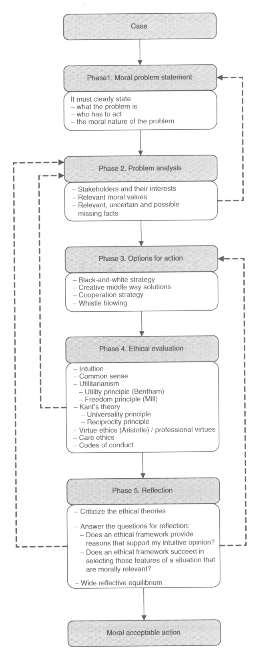
The Ethical Cycle
[dePoel&Royakkers2011]
Ethical Cycle: A tool to structuring and improving moral decisions by making a systematic and thorough analysis of the moral problem, which helps to come to moral judgements and justify the final decision in moral terms.
Phase 1: Moral problem statement
Phase 2: Problem analysis
Phase 3: Options for action
Phase 4: Ethical evaluation
Phase 5: Reflection
Notes:
[dePoel&Royakkers2011] Chapter 3, 4, 5
[Pereira&Saptawijaya2016] p. 110 trolly problem in different forms? Use to explain differences?
[Pereira&Saptawijaya2016] p. 20 double and triple effect & trolly problem
[Kizza2013] Chapter 3 Ethics abd Ethecial Analysis
[Reynolds2009] p. 19; overview

Slide 20

The Ethical Cycle
[dePoel&Royakkers2011]
Notes:
[dePoel&Royakkers2011] Chapter 3, 4, 5
[Pereira&Saptawijaya2016] p. 110 trolly problem in different forms? Use to explain differences?
[Pereira&Saptawijaya2016] p. 20 double and triple effect & trolly problem
[Kizza2013] Chapter 3 Ethics abd Ethecial Analysis
[Reynolds2009] p. 19; overview

Slide 21
The Ethical Cycle
[dePoel&Royakkers2011]
Notes:
[dePoel&Royakkers2011] Chapter 3, 4, 5
[Pereira&Saptawijaya2016] p. 110 trolly problem in different forms? Use to explain differences?
[Pereira&Saptawijaya2016] p. 20 double and triple effect & trolly problem
[Kizza2013] Chapter 3 Ethics abd Ethecial Analysis
[Reynolds2009] p. 19; overview

Slide 22
Methods for Analysing Risks during Specification

Slide 23
Ethical Questions in Design & Risk
[dePoel&Royakkers2011]
A moral problem during design relates to a value conflict with possible moral implications:
Value conflict: A value conflict arises if (1) a choice has to be be made between at least two options for which two values are relevant as choice criteria, (2) at least two different values select at least two different options best, and (3) the values do not trump each other.
Trumping (of values): If one value trumps another any(small) amount of the first value is worth more than any (large) amount of the second value.
Notes:
[dePoel&Royakkers2011] Chapter 6, 7?, 8, 10?
[Fleddermann2013] p. 67 line charting
[Fleddermann2013] p. 70 flow charting
Trump = übertrumpfen

Slide 24
Ethical Problem Analysis
[dePoel&Royakkers2011]
Cost-Benefit Analysis: A method for comparing alternatives in which the relevant advantages (benefits) and disadvantages (costs) of the options are expressed in monetary units and the overall monetary cost or benefit of each alternative is calculated.
Contingent Validation: An approach to express values like safety or sustainability in monetary unity by asking people how much they are willing to pay for a certain level of safety or sustainability (for example, the preservation of a piece of beautiful nature).
Incommensurability: Two (or more) values are incommensurable if they cannot be expressed or measured on a common scale or in terms of a common value measure.
Notes:
[dePoel&Royakkers2011] Chapter 6, 7?, 8, 10?
[Fleddermann2013] p. 67 line charting
[Fleddermann2013] p. 70 flow charting
Discount Rate: The rate that is used in cost-benefit analysis to discount future benefits (or costs). This is done because 1 dollar now is worth more than 1 dollar in 10 years.

Slide 25
Other Methods ...
[dePoel&Royakkers2011]
Threshold: The minimal level of a (design) criterion or value that an alternative has to meet in order to be acceptable with respect to that criterion or value.
Reasoning: An approach that aims at clarifying the values that underlie the conflicting design requirements by (1) identify relevant values, (2) specify the values, and (3) looking for common ground among values.
Value Sensitive Design: An approach that aims at integrating values of ethical importance in a systematic way in engineering design.
Notes:
[dePoel&Royakkers2011] Chapter 6, 7?, 8, 10?
[Fleddermann2013] p. 67 line charting
[Fleddermann2013] p. 70 flow charting
Trump = übertrumpfen

Slide 26
Comparison of the Methods ...
[dePoel&Royakkers2011]
Method | Weighting of values? | Main advantages | Main disadvantages
Cost-Benefit Analysis | All monetary | Options are made comparable | Values are treated as commensurable
Multiple Criteria Analysis | Trade-offs | Options are made comparable | Values are treated as commensurable
Thresholds | Minimal value | Selected alternatives meet thresholds | Are the thresholds independent?
Reasoning | Only related | Might solve value conflicts | Not all value conflicts can be solved this way
Value Sensitive Design | Not applicable | Can lead to better alternatives | May not solve the problem
Notes:
[dePoel&Royakkers2011] Chapter 6, 7?, 8, 10?
[Fleddermann2013] p. 67 line charting
[Fleddermann2013] p. 70 flow charting
Trump = übertrumpfen

Slide 27
When are Risks Acceptable?
[dePoel&Royakkers2011]
Informed consent: Principle that state the activities (experiments, risks) are acceptable if people have free consented to them after being fully informed about the (potential) risk and benefits of these activities (experiments, risks).
Risk-Cost-Benefit Analysis: This is a variant of regular cost-benefit analysis. The social costs for risks reduction are weighed against the social benefits offered by risk reduction, so achieving an optimal level of risk which the social benefits are highest.
Notes:
[dePoel&Royakkers2011] Chapter 6, 7?, 8, 10?
[Fleddermann2013] p. 67 line charting
[Fleddermann2013] p. 70 flow charting
Trump = übertrumpfen

Slide 28
When are Risks Acceptable?
[dePoel&Royakkers2011]
Best available technology: As an approach to acceptable risk (or acceptable environment emissions), best available technology refers to an approach that does not prescribe a specific technology but uses the best available technological alternative as yardstick for what is acceptable.
Precautionary Principle: Principle that prescribes how to deal with threats that are uncertain and/or cannot be scientifically established. In its most general form, the precautionary principle has the following general format: If there is (1) a threat, which is (2) uncertain, then (3) some kind of action (4) is mandatory. This definition has four dimensions: (1) the threat dimension; (2) the uncertainty dimension; (3) the action dimension, and (4) the prescription dimension.
Notes:
[dePoel&Royakkers2011] Chapter 6, 7?, 8, 10?
[Fleddermann2013] p. 67 line charting
[Fleddermann2013] p. 70 flow charting
Trump = übertrumpfen

Slide 29
Summary
Disaster or major failures of engineered systems result in the question of (moral) responsibility.
Normative Ethics tries to formulate normative recommendations about how to act or live, but no ethic theory is generally accepted and depending on the case the consequences, actions, nature of the acting person, or the group may all matter.
Therefore, it is suggested to use normative argumentation for specific moral problems and study possible actions rather than try to simply apply only one specific ethic theory.
Normative argumentation can employ the ethical cycle and valid or plausible arguments and has to uncover fallacies.
Several methods allow to study related value conflicts including the related moral problems (in particular risk) also during design.

Slide 30
Assignment-5
Think about how to express the ethical dilemmas in projects into a set of arguments.
Identify at least three valid argumentations
identify at least two argumentations with possible fallacies

Slide 31
Assignment-6 (May 23)
Use the normative arguments as input for you to apply the ethical cycle (slides 19-21) to refine the corresponding ethical dilemmas.
Outcome-1: Demonstrate that you applied the cycle. please briefly describe the main refinement steps that the cycle allowed you to do.
Outcome-2: Specify the risks and their mitigations
List the ethical risks: source, probability of happening (low, medium, high) and impact (low, medium, high)
Identify at least two value conflicts and value trumping related to one or more of these risks
Apply at least two methods for value conflict resolution (slide-26)
Based on the hypothetical outcomes of the value conflict resolution method, suggest designs for mitigating the risk (reduce probability and/or impact of risk)

Slide 32
END

